Slide 1
Organizational Behavior 15th Ed
Chapter 8
Robbins and Judge
Motivational:
From Concepts to Applications

Slide 2
Chapter 8 Learning Objectives
After studying this chapter you should be able to:
Describe the job characteristics model and evaluate the way it motivates by changing the work environment.
Compare and contrast the main ways jobs can be redesigned.
Identify three alternative work arrangements and show how they might motivate employees.
Give examples of employee involvement measures and show how they can motivate employees.
Demonstrate how the different types of variable-pay programs can increase employee motivation.
Show how flexible benefits turn benefits into motivators.
Identify the motivational benefits of intrinsic rewards.

Slide 3
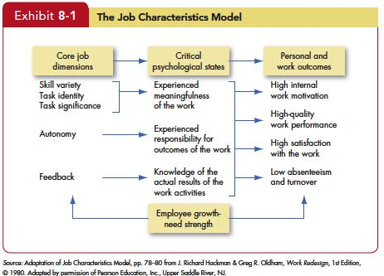
Describe the job characteristics model and evaluate the way it motivates by changing the work environment
LO 1

Slide 4
Describe the job characteristics model and evaluate the way it motivates by changing the work environment
LO 1
Motivating Potential Score (MPS)

Slide 5
Describe the job characteristics model and evaluate the way it motivates by changing the work environment
LO 1
Much evidence supports the JCM concept that the presence of a set of job characteristics—variety, identity, significance, autonomy, and feedback—does generate higher and more satisfying job performance.
A few studies have tested the job characteristics model in different cultures, but the results aren’t very consistent.

Slide 6
Compare and contrast the main ways jobs can be redesigned
LO 2
Repetitive jobs provide little variety, autonomy, or motivation.
Job Rotation
Referred to as cross-training.
Periodic shifting from one task to another.
Strengths of job rotation: reduces boredom, increases motivation, and helps employees better understand their work contributions.
Weaknesses include: creates disruptions, extra time for supervisors addressing questions, training time and efficiencies.

Slide 7
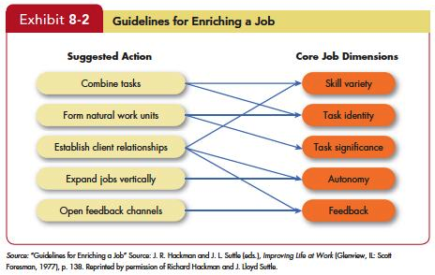
Compare and contrast the main ways jobs can be redesigned
LO 2

Slide 8
Compare and contrast the main ways jobs can be redesigned
LO 2
Some newer versions of job enrichment concentrate specifically on improving the meaningfulness of work.
One method is to relate employee experiences to customer outcomes.
Another method for improving the meaningfulness of work is providing employees with mutual assistance programs.

Slide 9
Compare and contrast the main ways jobs can be redesigned
LO 2
The evidence on job enrichment shows it reduces absenteeism and turnover costs and increases satisfaction, but not all programs are equally effective.
Some recent evidence suggests job enrichment works best when it compensates for poor feedback and reward systems.
Work design may also not affect everyone in the same way.

Slide 10
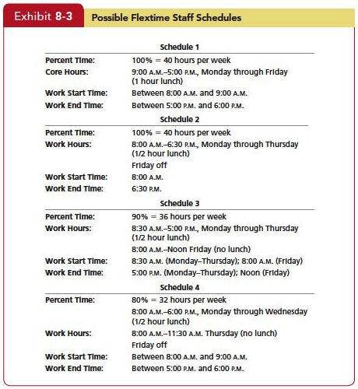
Identify three alternative work arrangements and show how they might motive employees
LO 2

Slide 11
Identify three alternative work arrangements and show how they might motive employees
LO 2
Job Sharing
Two or more people split a 40-hour-a-week job.
Approximately 19 percent of large organizations now offer job sharing.
Job sharing increases flexibility and can increase motivation and satisfaction when a 40-hour-a-week job is just not practical.
The major drawback is finding compatible pairs of employees who can successfully coordinate the intricacies of one job.

Slide 12
Identify three alternative work arrangements and show how they might motive employees
LO 2
Telecommuting
Employees who do their work at home at least two days a week on a computer that is linked to their office.
Notes:
Reasons for and against Telecommuting. Advantages
Larger labor pool
Higher productivity
Less turnover
Improved morale
Reduced office-space costs
Disadvantages
Employer
Less direct supervision of employees
Difficult to coordinate teamwork
Difficult to evaluate non-quantitative performance
Employee
May not be as noticed for his or her efforts

Slide 13
Identify three alternative work arrangements and show how they might motive employees
LO 3
Telecommuting Advantages
Larger labor pool
Higher productivity
Less turnover
Improved morale
Reduced office-space costs

Slide 14
Identify three alternative work arrangements and show how they might motive employees
LO 3
Telecommuting Disadvantages
Employer
Less direct supervision of employees
Difficult to coordinate teamwork
Difficult to evaluate non-quantitative performance
Employee
May not be noticed for his or her efforts

Slide 15
Give examples of employee involvement measures and show how they can motivate employees
LO 4
Employee Involvement- a participative process that uses employees’ input to increase their commitment to the organization’s success.
Common to all participative management programs is joint decision making,
subordinates share a significant degree of decision-making power with their immediate superiors.
But for it to work, employees must be engaged in issues relevant to their interests so they’ll be motivated, they must have the competence and knowledge to make a useful contribution, and trust and confidence must exist among all parties.

Slide 16
Give examples of employee involvement measures and show how they can motivate employees
LO 4
Representative participation
Its goal is to redistribute power within an organization, putting labor on a more equal footing with the interests of management and stockholders by letting workers be represented by a small group of employees who actually participate.
Almost every country in Western Europe requires companies to practice Representative participation.
The two most common forms:
Works councils
Board representatives

Slide 17
Demonstrate how the different types of variable-pay programs can increase employee motivation
LO 5
Variable-Pay Programs
A number of organizations are moving away from paying solely on credentials or length of service.
Piece-rate plans, merit-based pay, bonuses, profit sharing, gain sharing, and employee stock ownership plans are all forms of a variable-pay program.
Earnings therefore fluctuate up and down.

Slide 18
Demonstrate how the different types of variable-pay programs can increase employee motivation
LO 5
Piece-Rate Pay Plans
Workers are paid a fixed sum fore each unit of production completed.
A pure piece-rate plan provides no base salary and pays the employee only for what he or she produces.
Although incentives are motivating and relevant for some jobs, it is unrealistic to think they can constitute the only piece of some employees’ pay.

Slide 19
Demonstrate how the different types of variable-pay programs can increase employee motivation
LO 5
Merit-Based Pay Plans—based on performance appraisal ratings.
Main advantage is that it allows employers to differentiate pay based on performance.
Create perceptions of relationships between performance and rewards.
Limitations include: based on annual performance appraisal; merit pool fluctuations based on economic conditions; unions typically resist merit pay plans.

Slide 20
Demonstrate how the different types of variable-pay programs can increase employee motivation
LO 5
Bonuses—becoming a wider used system in many organizations.
An annual bonus is a significant component of total compensation for many jobs.
Bonus plans increasingly include lower-ranking employees; many companies now routinely reward production employees with bonuses in the thousands of dollars when profits improve.
Downsides of bonuses: employees’ pay is more vulnerable to cuts.

Slide 21
Demonstrate how the different types of variable-pay programs can increase employee motivation
LO 5
Skill-Based Pay
An alternative to job-based pay bases pay levels on how many skills employees have or how many jobs they can do.
Skill-based pay plans increase the flexibility of the workforce.
Skill-based pay also facilitates communication across the organization because people gain a better understanding of each other’s jobs.

Slide 22
Demonstrate how the different types of variable-pay programs can increase employee motivation
LO 5
Profit-sharing plans are organization-wide programs that distribute compensation based on some established formula centered around a company’s profitability.
Profit-sharing plans at the organizational level appear to have positive effects on employee attitudes.

Slide 23
Demonstrate how the different types of variable-pay programs can increase employee motivation
LO 5
An employee stock ownership plan (ESOP) is a company-established benefit plan in which employees acquire stock, often at below-market prices, as part of their benefits.
Research on ESOPs indicates they increase employee satisfaction and innovation.
ESOP plans for top management can reduce unethical behavior.

Slide 24
Demonstrate how the different types of variable-pay programs can increase employee motivation
LO 5
Do variable-pay programs increase motivation and productivity?
The answer is a qualified “yes.”
Studies generally support the idea that organizations with profit-sharing plans have higher levels of profitability than those without them.

Slide 25
Show how flexible benefits turn benefits into motivators
LO 6
Developing a Benefits Package
The idea is to allow each employee to choose a benefit package that is individually tailored to his/her own needs and situation.
An organization sets up a flexible spending account for each employee, usually based on some percentage of his or her salary, and then a price tag is put on each benefit.

Slide 26
Show how flexible benefits turn benefits into motivators
LO 6
There are three basic types of programs:
Modular Plans: Pre-designed with each module meeting needs of a specific group of employees.
Core-plus Plans: A core of essential benefits and a menu like selection of other benefit options.
Flexible Spending Plans: Employees set aside a specific dollar amount for benefits tax-free and draw against the account for medical and dental services as needed.

Slide 27
Identify the motivational benefits of intrinsic rewards
LO 7
Intrinsic Rewards in Employee Recognition Programs
Organizations are increasingly recognizing that important work rewards can be both intrinsic and extrinsic.
Rewards are intrinsic in the form of employee recognition programs and extrinsic in the form of compensation systems.

Slide 28

Identify the motivational benefits of intrinsic rewards
LO 7

Slide 29
Summary and Implications for Managers
LO 7
Managers should be sensitive to individual differences.
Spend the time necessary to understand what’s important to each employee.
Use Goals and Feedback. Employees should have firm, specific goals, and they should get feedback on how well they are faring in pursuit of those goals.

Slide 30
Summary and Implications for Managers
LO 7
Allow employees to participate in decisions that affect them.
Link rewards to performance.
Check the system for equity.

Slide 31

All rights reserved. No part of this publication may be reproduced, stored in a retrieval system, or transmitted, in any form or by any means, electronic, mechanical, photocopying, recording, or otherwise, without the prior written permission of the publisher. Printed in the United States of America.
Copyright © 2013 Pearson Education, Inc. publishing as Prentice Hall
Notes:
All rights reserved. No part of this publication may be reproduced, stored in a retrieval system, or transmitted, in any form or by any means, electronic, mechanical, photocopying, recording, or otherwise, without the prior written permission of the publisher. Printed in the United States of America.

